Slide 1
PHP Web
Course Introduction
SoftUni Team
Technical Trainers
Software University
https://softuni.bg/

Slide 2
Table of Contents
Course Objectives
Training and Team
Course Organization
Course Infrastructure
Evaluation Criteria

Slide 3
Have a Question?
sli.do
#php-web

Slide 4

Course Objectives

Slide 5
Php Web Basic Course Goals
Basic knowledge over HTML and CSS
Fundamental knowledge over what is HTTP and how it works
Creating and using classes and objects, abstraction, polymorphism, inheritance, encapsulation
Fundamental knowledge over what is a database and how it works
Fundamental knowledge for creating web applications

Slide 6
Practical Exam
Practical exam for 4 hours
Creating a database using SQL
Creating CRUD Application using the learned syntax, technologies and database
Solutions are evaluated for each participant by hand

Slide 7

The Team

Slide 8
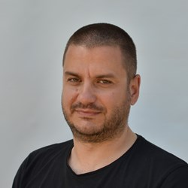

Trainers Team
Veselin Malezanov
Trainer @ Software University
20+ years of experience with PHP
Takes an active role in the development of www.abv.bg

Slide 9
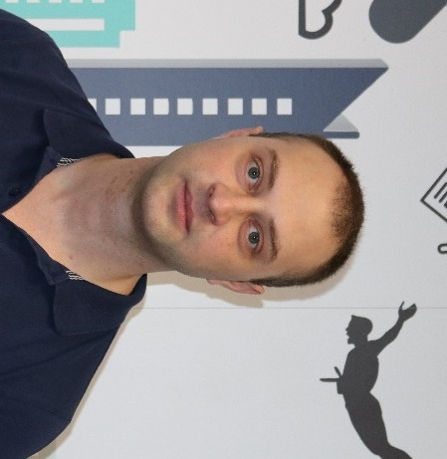
Trainers Team
Mihail Velikov
Team Lead and Trainer @ SoftUni
Interested in Java, C#, JavaScript and PHP web development

Slide 10

Course Organization

Slide 11
Php Web Basic Module – Timeline
17-Sept-2018
12-Nov-2018
PHP Web Development Basic
8 weeks * 4 times / week
9 credits
Start: 17-Sept-2018
Final exam: 11-Nov-2018
PHP MVC Frameworks
5 weeks * 4 times / week
12 credits
Start: 12-Nov-2018
Final exam: TBA
Re-Take Exams
TBA

Slide 12

Homework Assignments & Exercises
Your homework is mainly work in class
Lesson days → slides + live demos + exercises
Exercise days → only exercises
How to submit your homework?
Submitted in the judge system
Do your homework when it's due
Assignments pile up quickly

Slide 13


Scoring System for the Course
Mandatory:
Final exam – 90%
Exercises & homework – 10%
Bonuses:
Presence in class – 5% bonus
Forum activity – bonus up to 5%

Slide 14



Course Web Site, Forum and FB Group
Official web site:
Official discussion forum:
Official Facebook group:
https://softuni.bg/courses/php-basics/
softuni.bg/forum/categories/10/
https://www.facebook.com/groups/SoftUniPXPWebSeptember2018

Slide 15
Useful websites for php learning
PHP Manual7
https://secure.php.net/manual/en/index.php
The Learn PHP Tutorial
https://www.tutorialspoint.com/php/
PHP Tutorial by W3CSchool
https://www.w3schools.com/php/
PHP The Right Way
https://phptherightway.com/

Slide 16
https://softuni.bg/trainings/courses

Slide 17













SoftUni Diamond Partners

Slide 18




SoftUni Organizational Partners

Slide 19




Trainings @ Software University (SoftUni)
Software University – High-Quality Education and Employment Opportunities
softuni.bg
Software University Foundation
http://softuni.foundation/
Software University @ Facebook
facebook.com/SoftwareUniversity
Software University Forums
forum.softuni.bg

Slide 20

License
This course (slides, examples, demos, videos, homework, etc.) is licensed under the "Creative Commons Attribution-NonCommercial-ShareAlike 4.0 International" license

